Slide 1
Sistem Persamaan Linier
Aljabar Linier

Slide 2
Persamaan Linier
Persamaan linier dengan n variabel
a₁x₁ + a₂x₂ +· · ·+a_{n}x_{n} = b
Kasus khusus: persamaan linier homogen
a₁x₁ + a₂x₂ +· · ·+a_{n}x_{n} = 0

Slide 3
Linear Systems in Two and Three Unknowns
A finite set of linear equations is called a system of linear equations or, more briefly, a linear system.
A general linear system of m equations in the n unknowns
a₁₁x₁ + a₁₂x₂ + · · · + a_{1n}x_{n} = b₁
a₂₁x₁ + a₂₂x₂ + · · · + a_{2n}x_{n} = b₂
… … … …
a_{m1}x₁ + a_{m2}x₂ + · · · + a_{mn}x_{n} = b_{m}

Slide 4
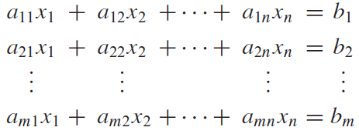
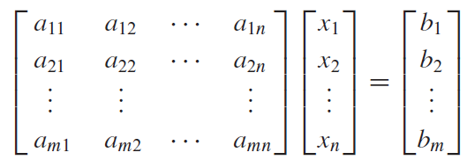
Matrix Form of a Linear System

Slide 5
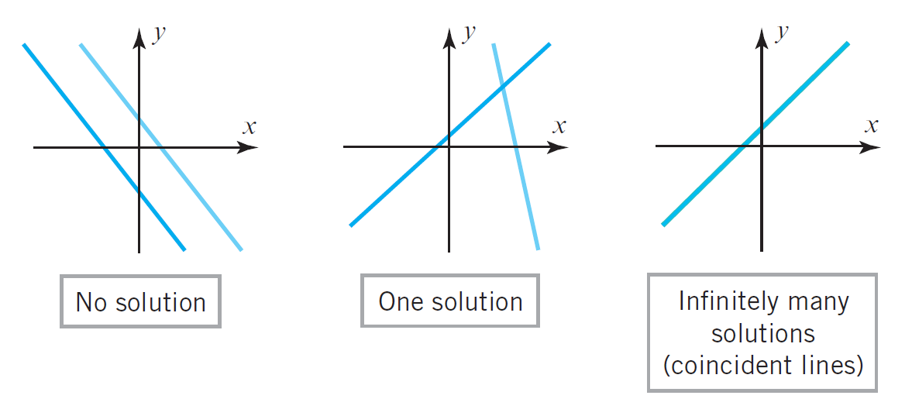
Penyelesaian Sistem Persamaan Linier dengan dua variabel
Setiap sistem persamaan linier hanya memiliki tiga kemungkinan penyelesaian: tidak ada solusi, solusi tunggal, atau solusi tak terhingga.

Slide 6
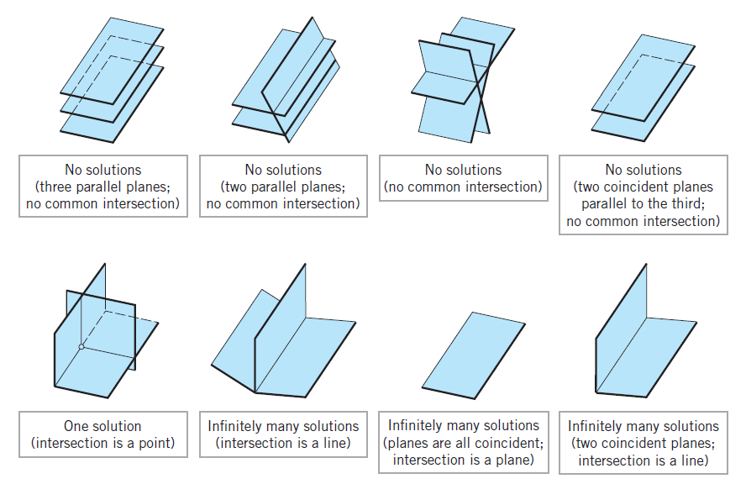
Solution of a linear system a linear system of three equations in three unknowns

Slide 7
Solution ?

Slide 8
Augmented Matrices and Elementary Row Operations

Slide 9
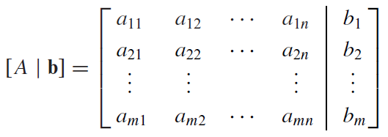
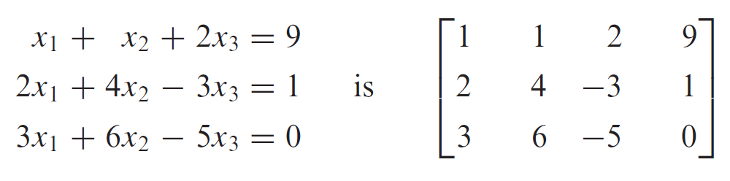
Augmented Matrix

Slide 10
Matriks Eselon Baris
Adalah kasus khusus matriks segitiga
Karakteristik:
Jika sebuah baris tidak seluruh elemennya bernilai “0”, maka elemen bukan-nol pertama (paling kiri) bernilai “1”. Elemen ini disebut sebagai “awalan 1”.
Jika ada baris yang seluruh elemennya bernilai “0”, maka baris-baris tersebut dikelompokkan dan diposisikan ulang sebagai baris-baris terbawah matriks.
Untuk dua buah baris berurutan yang tidak seluruh elemennya bernilai “0”, “awalan 1” dari baris yang lebih rendah terletak di kolom yang lebih kanan dibanding “awalan 1” dari baris di atasnya

Slide 11
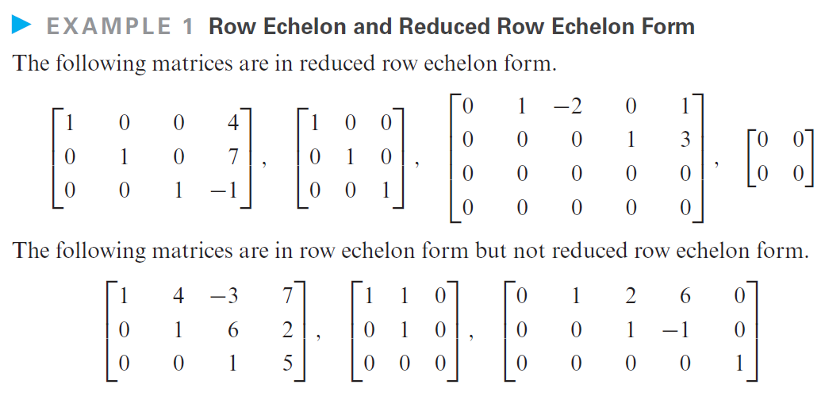
Matriks Eselon Baris Tereduksi
Adalah kasus khusus matriks diagonal.
Memiliki karakteristik Matriks Eselon Baris, dan
Jika sebuah kolom mengandung “awalan 1”, maka elemen-elemen lain dalam kolom tersebut bernilai “0”.
Notes:
THEOREM 1.4.3 If R is the reduced row echelon form of an n × n matrix A, then either
R has a row of zeros or R is the identity matrix In.

Slide 12
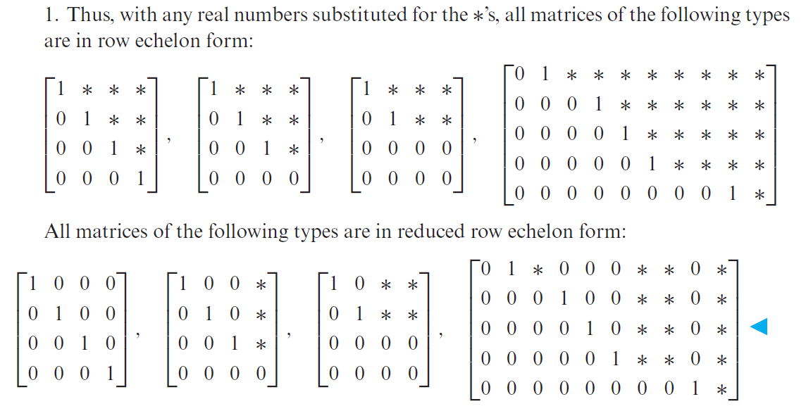
Eselon Baris & Eselon Baris Tereduksi

Slide 13
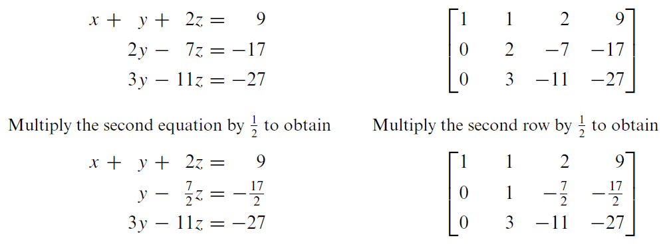
Elementary Row Operations
Multiply a row through by a nonzero constant.
Interchange two rows.
Add a constant times one row to another.

Slide 14
Elementary Row Operations
Multiply a row through by a nonzero constant.
Interchange two rows.
Add a constant times one row to another.

Slide 15
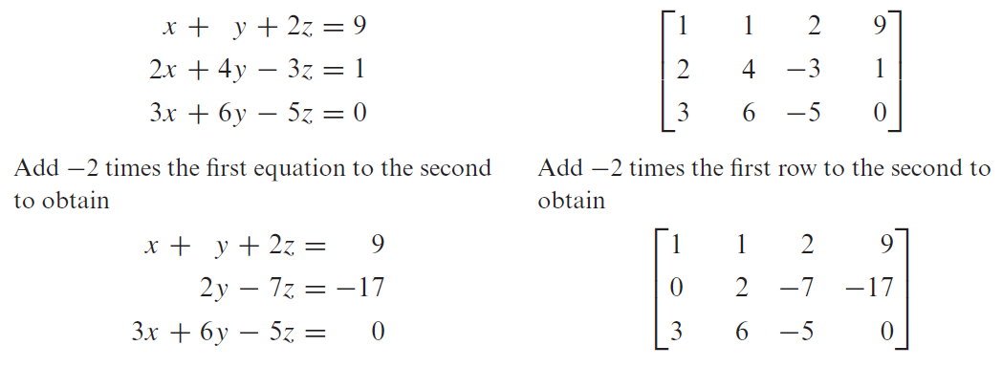
Elementary Row Operations
Multiply a row through by a nonzero constant.
Interchange two rows.
Add a constant times one row to another.

Slide 16
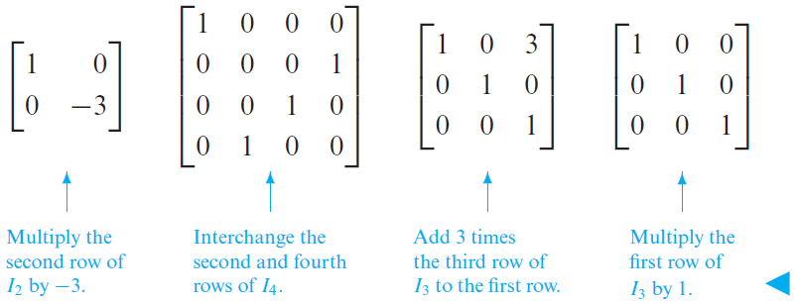
Matriks Elementer
Adalah matriks yang diperoleh dengan melakukan sebuah operasi baris elementer (tunggal) terhadap matriks identitas.
Notes:
DEFINITION 1 Matrices A and B are said to be row equivalent if either (hence each) can be obtained from the other by a sequence of elementary row operations.
DEFINITION 2 A matrix E is called an elementary matrix if it can be obtained from an identity matrix by performing a single elementary row operation.

Slide 17
Matriks Elementer
THEOREM 1.5.2 Every elementary matrix is invertible, and the inverse is also an elementary matrix.
Notes:
DEFINITION 1 Matrices A and B are said to be row equivalent if either (hence each) can be obtained from the other by a sequence of elementary row operations.
DEFINITION 2 A matrix E is called an elementary matrix if it can be obtained from an identity matrix by performing a single elementary row operation.

Slide 18
Ekivalensi Baris Matriks
Matriks A dan B dikatakan row-equivalent jika matriks A dapat diperoleh dengan melakukan serangkaian operasi baris elementer terhadap matriks B, dan sebaliknya.

Slide 19
Some Facts About Echelon Forms
Every matrix has a unique reduced row echelon form;
regardless of whether you use Gauss–Jordan elimination or some other sequence of elementary row operations, the same reduced row echelon form will result in the end.*
Row echelon forms are not unique;
different sequences of elementary row operations can result in different row echelon forms.
Although row echelon forms are not unique, the reduced row echelon form and all row echelon forms of a matrix A have the same number of zero rows, and the leading 1’s always occur in the same positions.
Those are called the pivot positions of A. A column that contains a pivot position is called a pivot column of A.

Slide 20
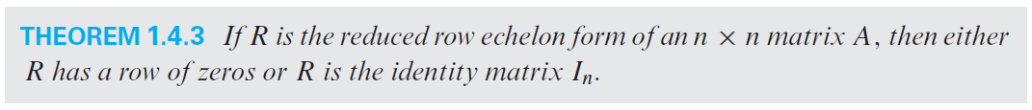
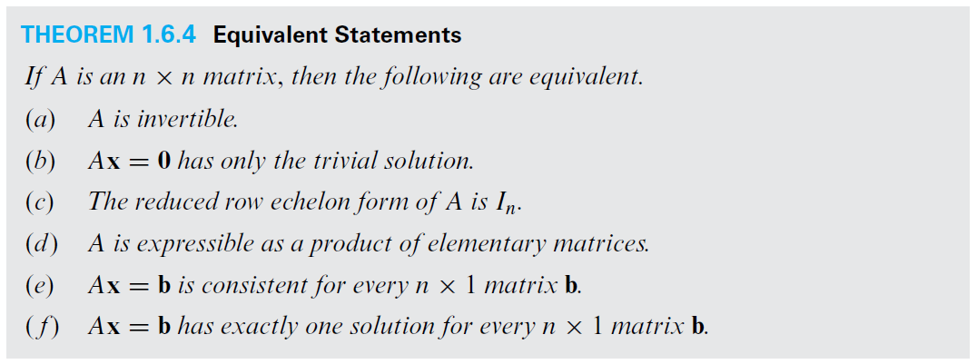

Slide 21
Gaussian Elimination

Slide 22
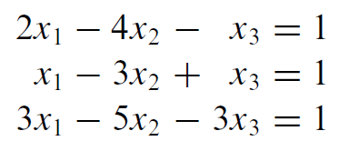
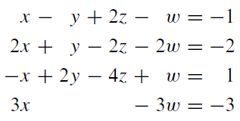
(Reduced) Row Echelon Form ?

Slide 23
Gauss–Jordan Elimination
The procedure (or algorithm) for reducing a matrix to reduced row echelon form.
Consists of two parts: (1) a forward phase in which zeros are introduced below the leading 1’s, and (2) a backward phase in which zeros are introduced above the leading 1’s.
If only the forward phase is used, then the procedure produces a row echelon form and is called Gaussian elimination.

Slide 24
Gaussian Elimination and Back-Substitution
For small linear systems that are solved by hand, Gauss–Jordan elimination is a good procedure to use.
However, for large linear systems that require a computer solution, it is generally more efficient to use Gaussian elimination (reduction to row echelon form) followed by a technique known as back-substitution to complete the process of solving the system.

Slide 25
Homogeneous Linear Systems
A system of linear equations is said to be homogeneous if the constant terms are all zero;
Every homogeneous system of linear equations is consistent
because all such systems have x₁ = 0, x₂ = 0, . . . , x_{n} = 0 as a solution. (called the trivial solution. if there are other solutions, they are called nontrivial solutions )
a₁₁x₁ + a₁₂x₂ + · · · + a_{1n}x_{n} = 0
a₂₁x₁ + a₂₂x₂ + · · · + a_{2n}x_{n} = 0
… … … …
a_{m1}x₁ + a_{m2}x₂ + · · · + a_{mn}x_{n} = 0

Slide 26
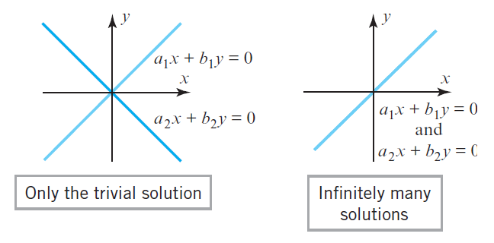
Penyelesaian Sistem Persamaan Linier Homogen
Dua kemungkinan penyelesaian sistem persamaan linier homogen:
Solusi trivial (tunggal).
Solusi tak terhingga (selain solusi tunggal-trivial).

Slide 27
Homogeneous Linear Systems
Two important points about solving homogeneous linear systems:
Operasi baris elementer tidak mengubah kolom-kolom dalam sebuah matriks yang seluruh elemennya bernilai “0”.
Seluruh elemen dari kolom paling kanan dari matriks eselon baris tereduksi bernilai “0”. (homogen dengan sistem persamaan linier sebelum mengalami O.B.E).
…

Slide 28
Homogeneous Linear Systems
Two important points about solving homogeneous linear systems:
…
When we constructed the homogeneous linear system corresponding to augmented matrix, we ignored the row of zeros because the corresponding equation
0x₁ + 0x₂ + 0x₃ + 0x₄ + 0x₅ + 0x₆ = 0
does not impose any conditions on the unknowns.
Thus, depending on whether or not the reduced row echelon form of the augmented matrix for a homogeneous linear system has any rows of zero, the linear system corresponding to that reduced row echelon form will either have the same number of equations as the original system or it will have fewer.

Slide 29
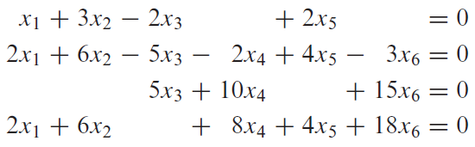
Solution ?
Notes:
Free variables : x2, x4, x5

Slide 30
Theorems for Homogeneous Systems
“If a homogeneous linear system has n unknowns, and if the reduced row echelon form of its augmented matrix has r nonzero rows, then the system has n − r free variables.”
“A homogeneous linear system with more unknowns than equations has infinitely many solutions.”

Slide 31
Roundoff Error and Instability
computers generally approximate numbers, thereby introducing roundoff errors,
unless precautions are taken, successive calculations may degrade an answer to a degree that makes it useless.
Algorithms (procedures) in which this happens are called unstable.

Slide 32
A Method for Inverting Matrices
To find the inverse of an invertible matrix A, find a sequence of elementary row operations that reduces A to the identity and then perform that same sequence of operations on I_{n} to obtain A⁻¹.

Slide 33
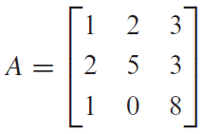
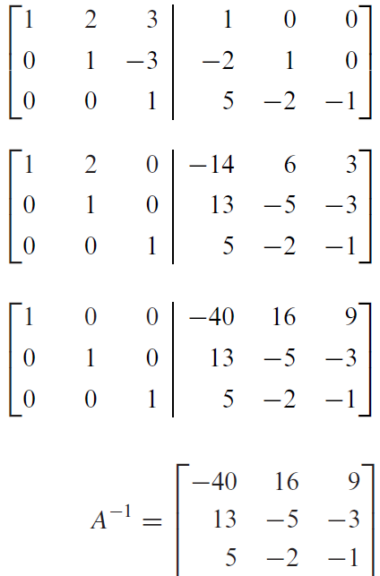
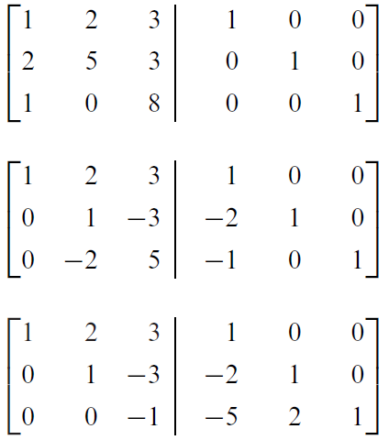
A Method for Inverting Matrices

Slide 34
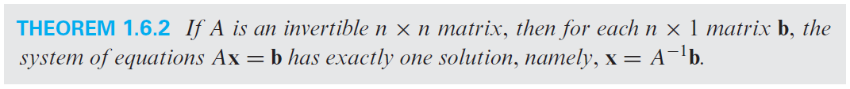
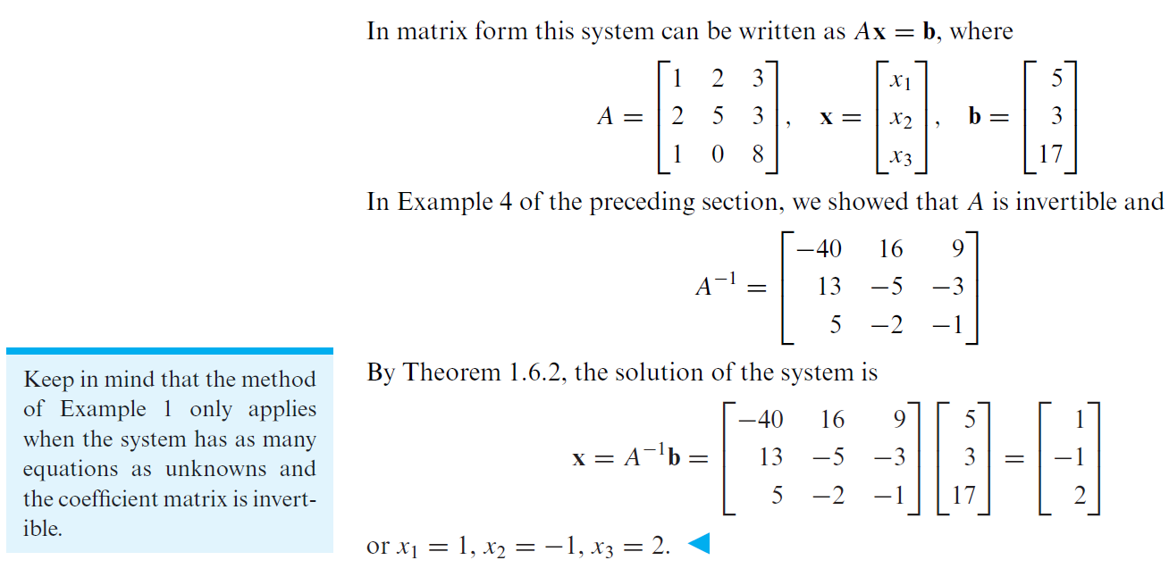
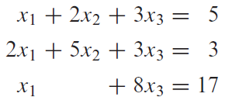
Solving Linear Systems by Matrix Inversion

Slide 35
Questions ?

